Slide 1



Update from the Cape Light Compact
Your Trusted, Local Energy Resource
Maggie Downey, Chief Administrative Officer

Slide 2
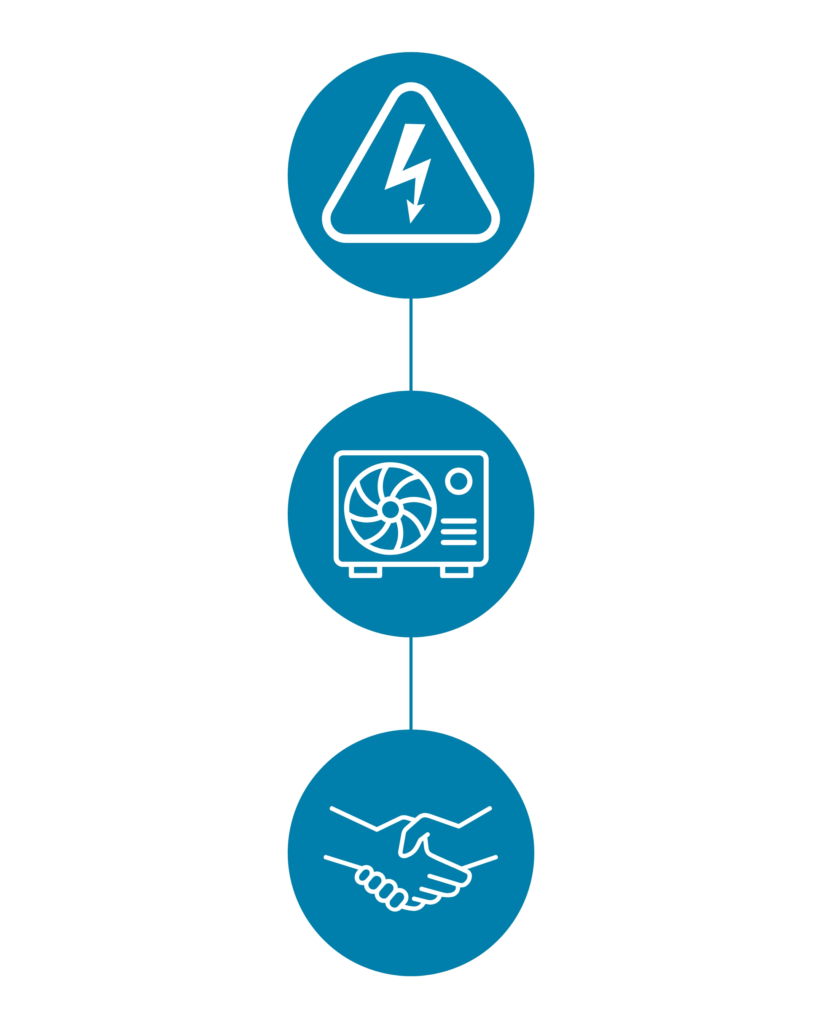


Who is Cape Light Compact?
The Compact is a Joint Powers Entity (JPE) governed by a board of directors appointed by each of the 21 towns of Cape Cod and Martha’s Vineyard, and Dukes County
CLC is the Mass Save Sponsor for Cape Cod and Martha’s Vineyard
Our office is located at
261 Whites Path in S. Yarmouth
Providing 100% Renewable Electricity Supply for Cape Cod and Martha’s Vineyard Residents.
Electricity Supply
Offering rebates and incentives to residents and businesses to make energy efficient upgrades as the local Mass Save Sponsor.
Energy Efficiency
Ensuring Cape Cod and Martha’s Vineyard energy interests are represented at the state level
Consumer Advocacy

Slide 3
West Tisbury Energy Efficiency Results for 2024
Jan – Dec 2024 | # of Participants | Rebates/Incentives Paid to Customers
Low Income | 18 | $72,328.70
Residential | 381 | $195,437.74
Commercial | 18 | $95,913.81
Total | 417 | $363,680.26

Slide 4



2025-2027 Energy Efficiency Plan
Policy Goals for 2025-2027
Decarbonization
Equity
Customer experience

Slide 5
From Energy Efficiency to Decarbonization
Cape Light Compact - Mass Save - shifting focus from energy Efficiency to Decarbonization.
  Continuing our electrification efforts
  Encouraging customers to replace existing fossil fuels equipment with high-efficiency heat pumps. Including heating systems, cooking equipment, and water heaters
As required by the MA Climate Act of 2022, rebates for fossil fuel equipment including gas, oil, and propane furnaces and burners were phased out at the end of 2024
  Heat Loans are no longer available for fossil fuel equipment.

Slide 6
Income Limits for Enhanced Moderate Income Residents
Duke's County Income Levels
# of Occupants | Qualification | Household income
1 | 60% | $51,778
 | 80% | $72,950
2 | 60% | $67,710
 | 80% | $90,279
3 | 60% | $83,642
 | 80% | $111,522
4 | 60% | $99,574
 | 80% | $132,764
5 | 60% | $115,505
 | 80% | $154,006
6 | 60% | $131,437
 | 80% | $175,248
7 | 60% | $134,424
 | 80% | $179,231
8 | 60% | $137,411
 | 80% | $183,214
Notes:
Foodservice
Combination Oven
Steamer
Fryer
Dishwashers
Freezers and Refrigerators
HVAC
Air-Conditioning Rooftop Units
ECM Pumps
High-Efficiency Condensing Units for Refrigeration
HVAC Controls

Slide 7
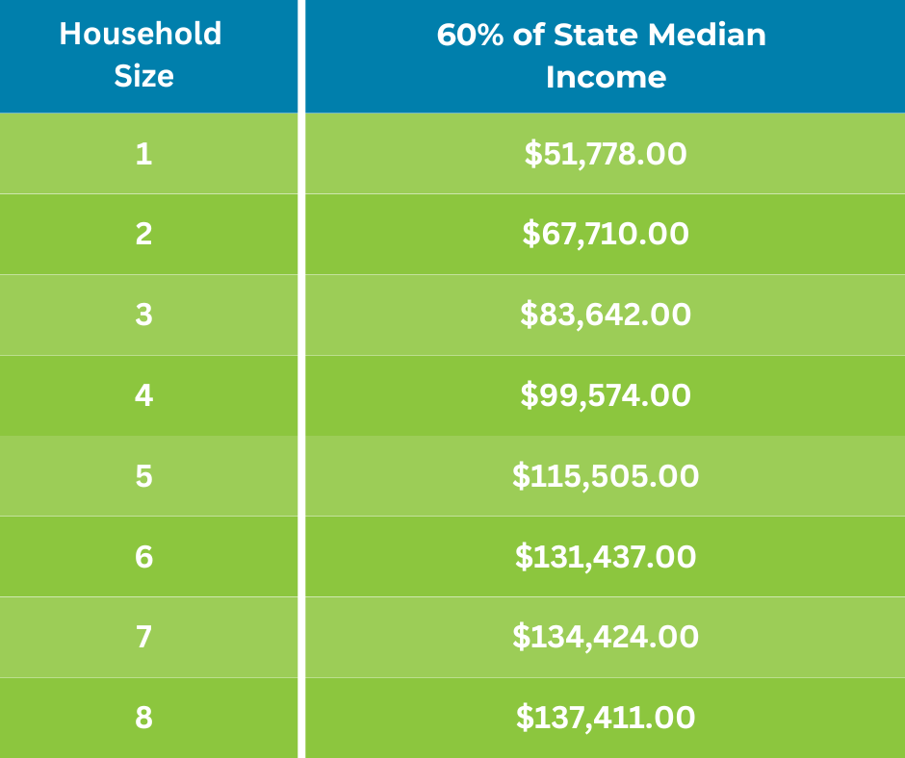
Income Eligible (IE) Energy Efficiency Retrofit Program
Individual Eligibility*
  For customers with income 60% or less of state median income (SMI)
  Customers are qualified in 1 of 3 ways
    Must be on the electric discount rate with Eversource or
    Fuel Assistance (FA) or
    Income verified directly by CLC (n/a for natural gas customers)
Begins with an energy assessment
All measures are direct install and covered 100%
    Weatherization, appliance upgrades, heat pumps, heat pump
    water heaters
    Weatherization barrier remediation* – knob & tube removal;
    roof repair; vermiculite or asbestos removal; mold/moisture remediation
Lead Vendor is Housing Assistance Corp (HAC), in LEAN network
For more information and to enroll, contact CLC at 1-800-797-6699
*Multi-family sites qualify for EE service as IE when 50% or more of units are restricted to households making 60% or less of either area median income/state median income (AMI/SMI)
2025 Season Income Limits
Beginning October 1, 2025
Notes:
Foodservice
Combination Oven
Steamer
Fryer
Dishwashers
Freezers and Refrigerators
HVAC
Air-Conditioning Rooftop Units
ECM Pumps
High-Efficiency Condensing Units for Refrigeration
HVAC Controls

Slide 8
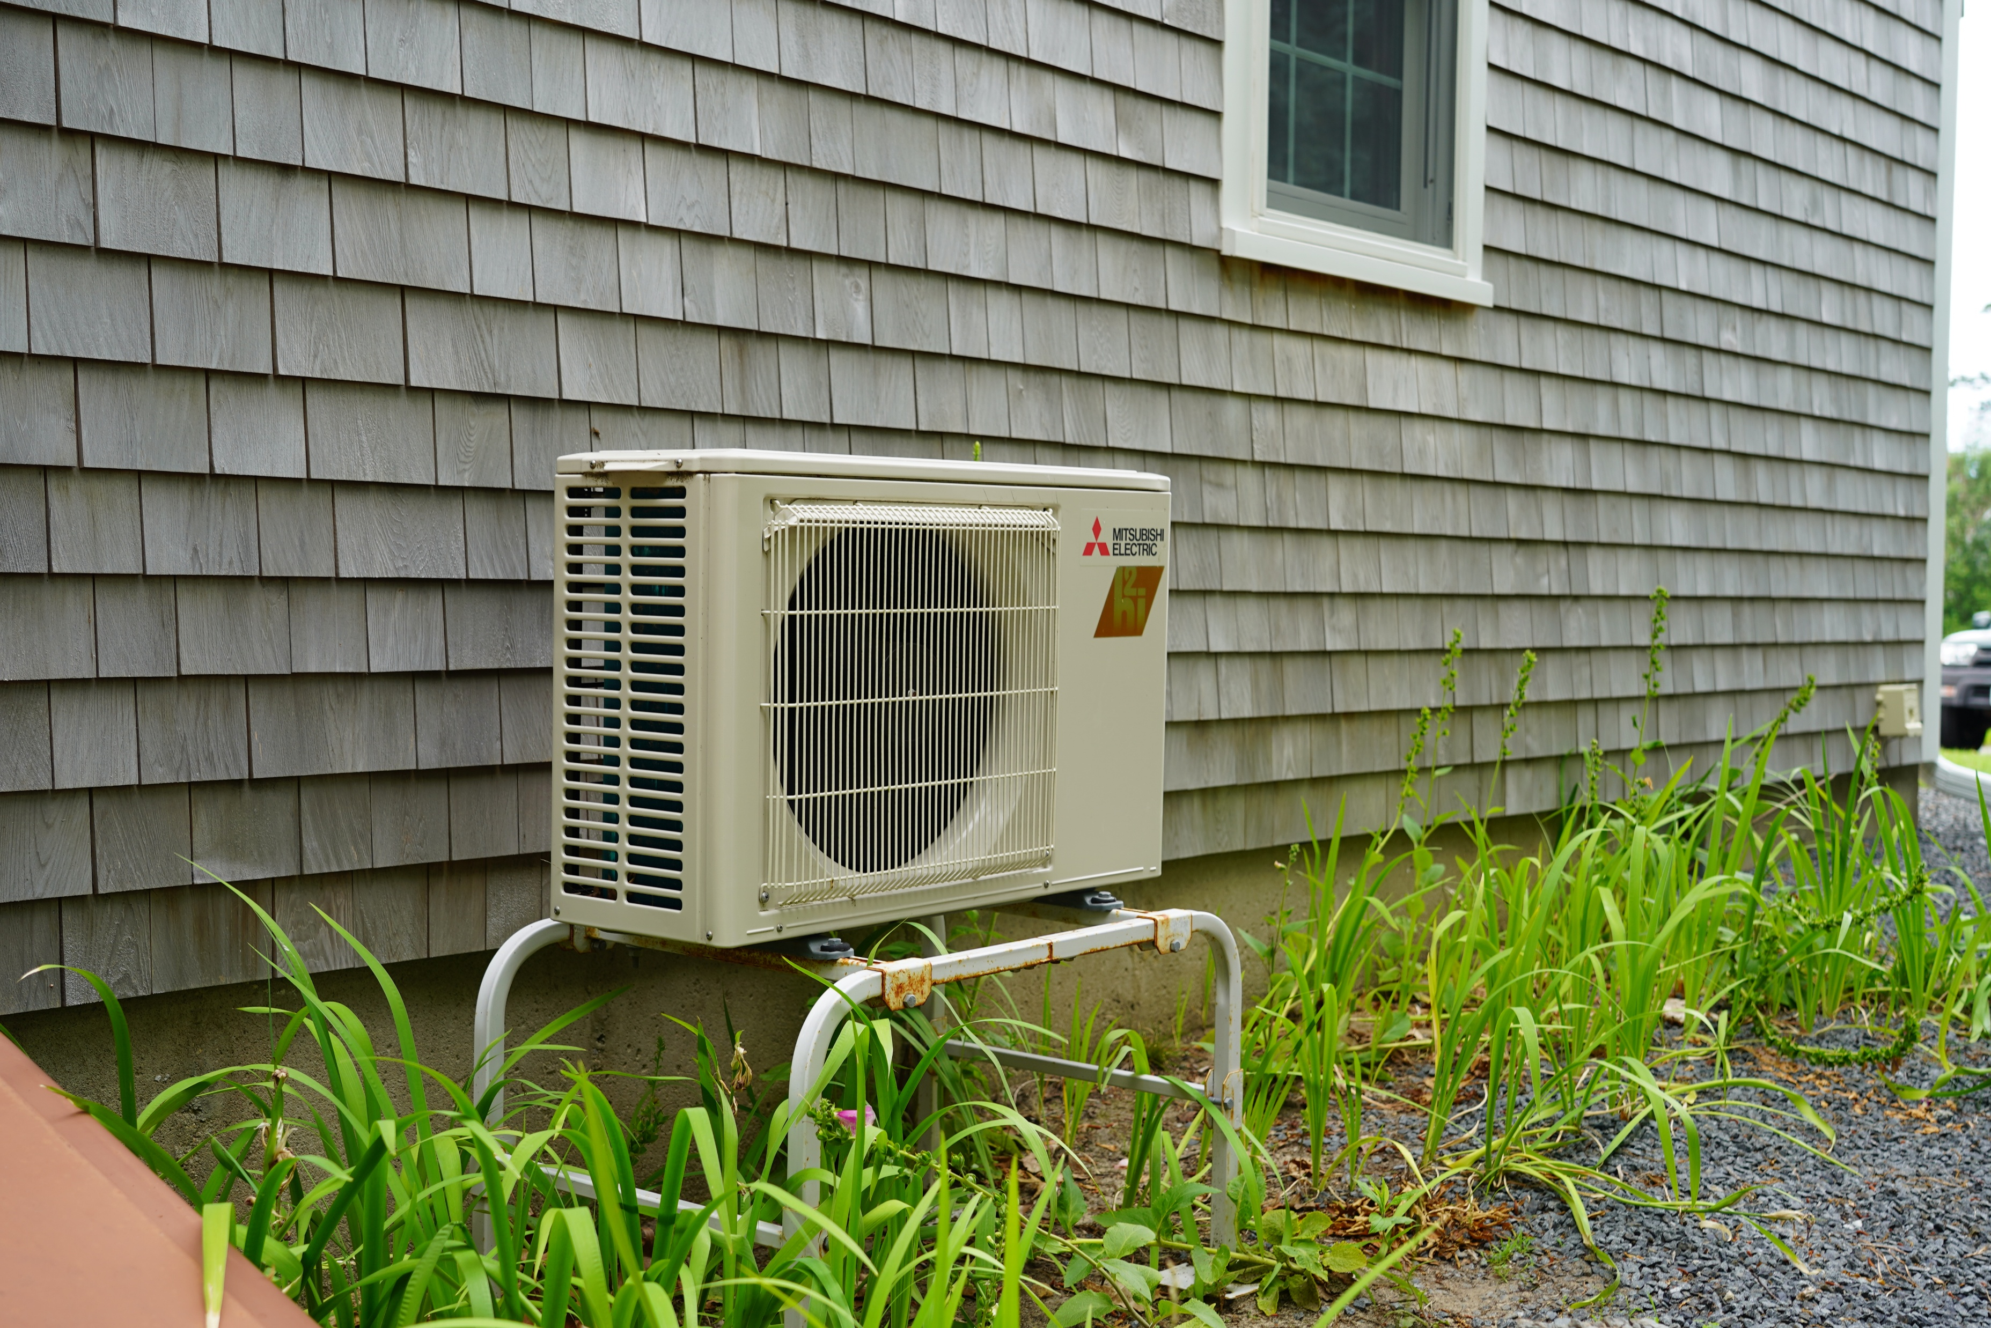
Heat Pump Rate
What is a Heat Pump Rate?
  A new electric rate on the deliver portion of the electric bill for residential customers. The rate reduces the per-kilowatt-hour distribution and transmission charges from November through April.
Who is eligible?
  Any residential customer who uses a heat pump for space heating all or part of their home.
When does the rate go into effect?
  The heat pump rate starts November 1, 2025.
How do I sign up?
  Customers who installed their heat pumps through Mass Save after January 1, 2022, should be automatically enrolled. Customers who installed heat pumps before January 1, 2022, must call Eversource to enroll.

Slide 9
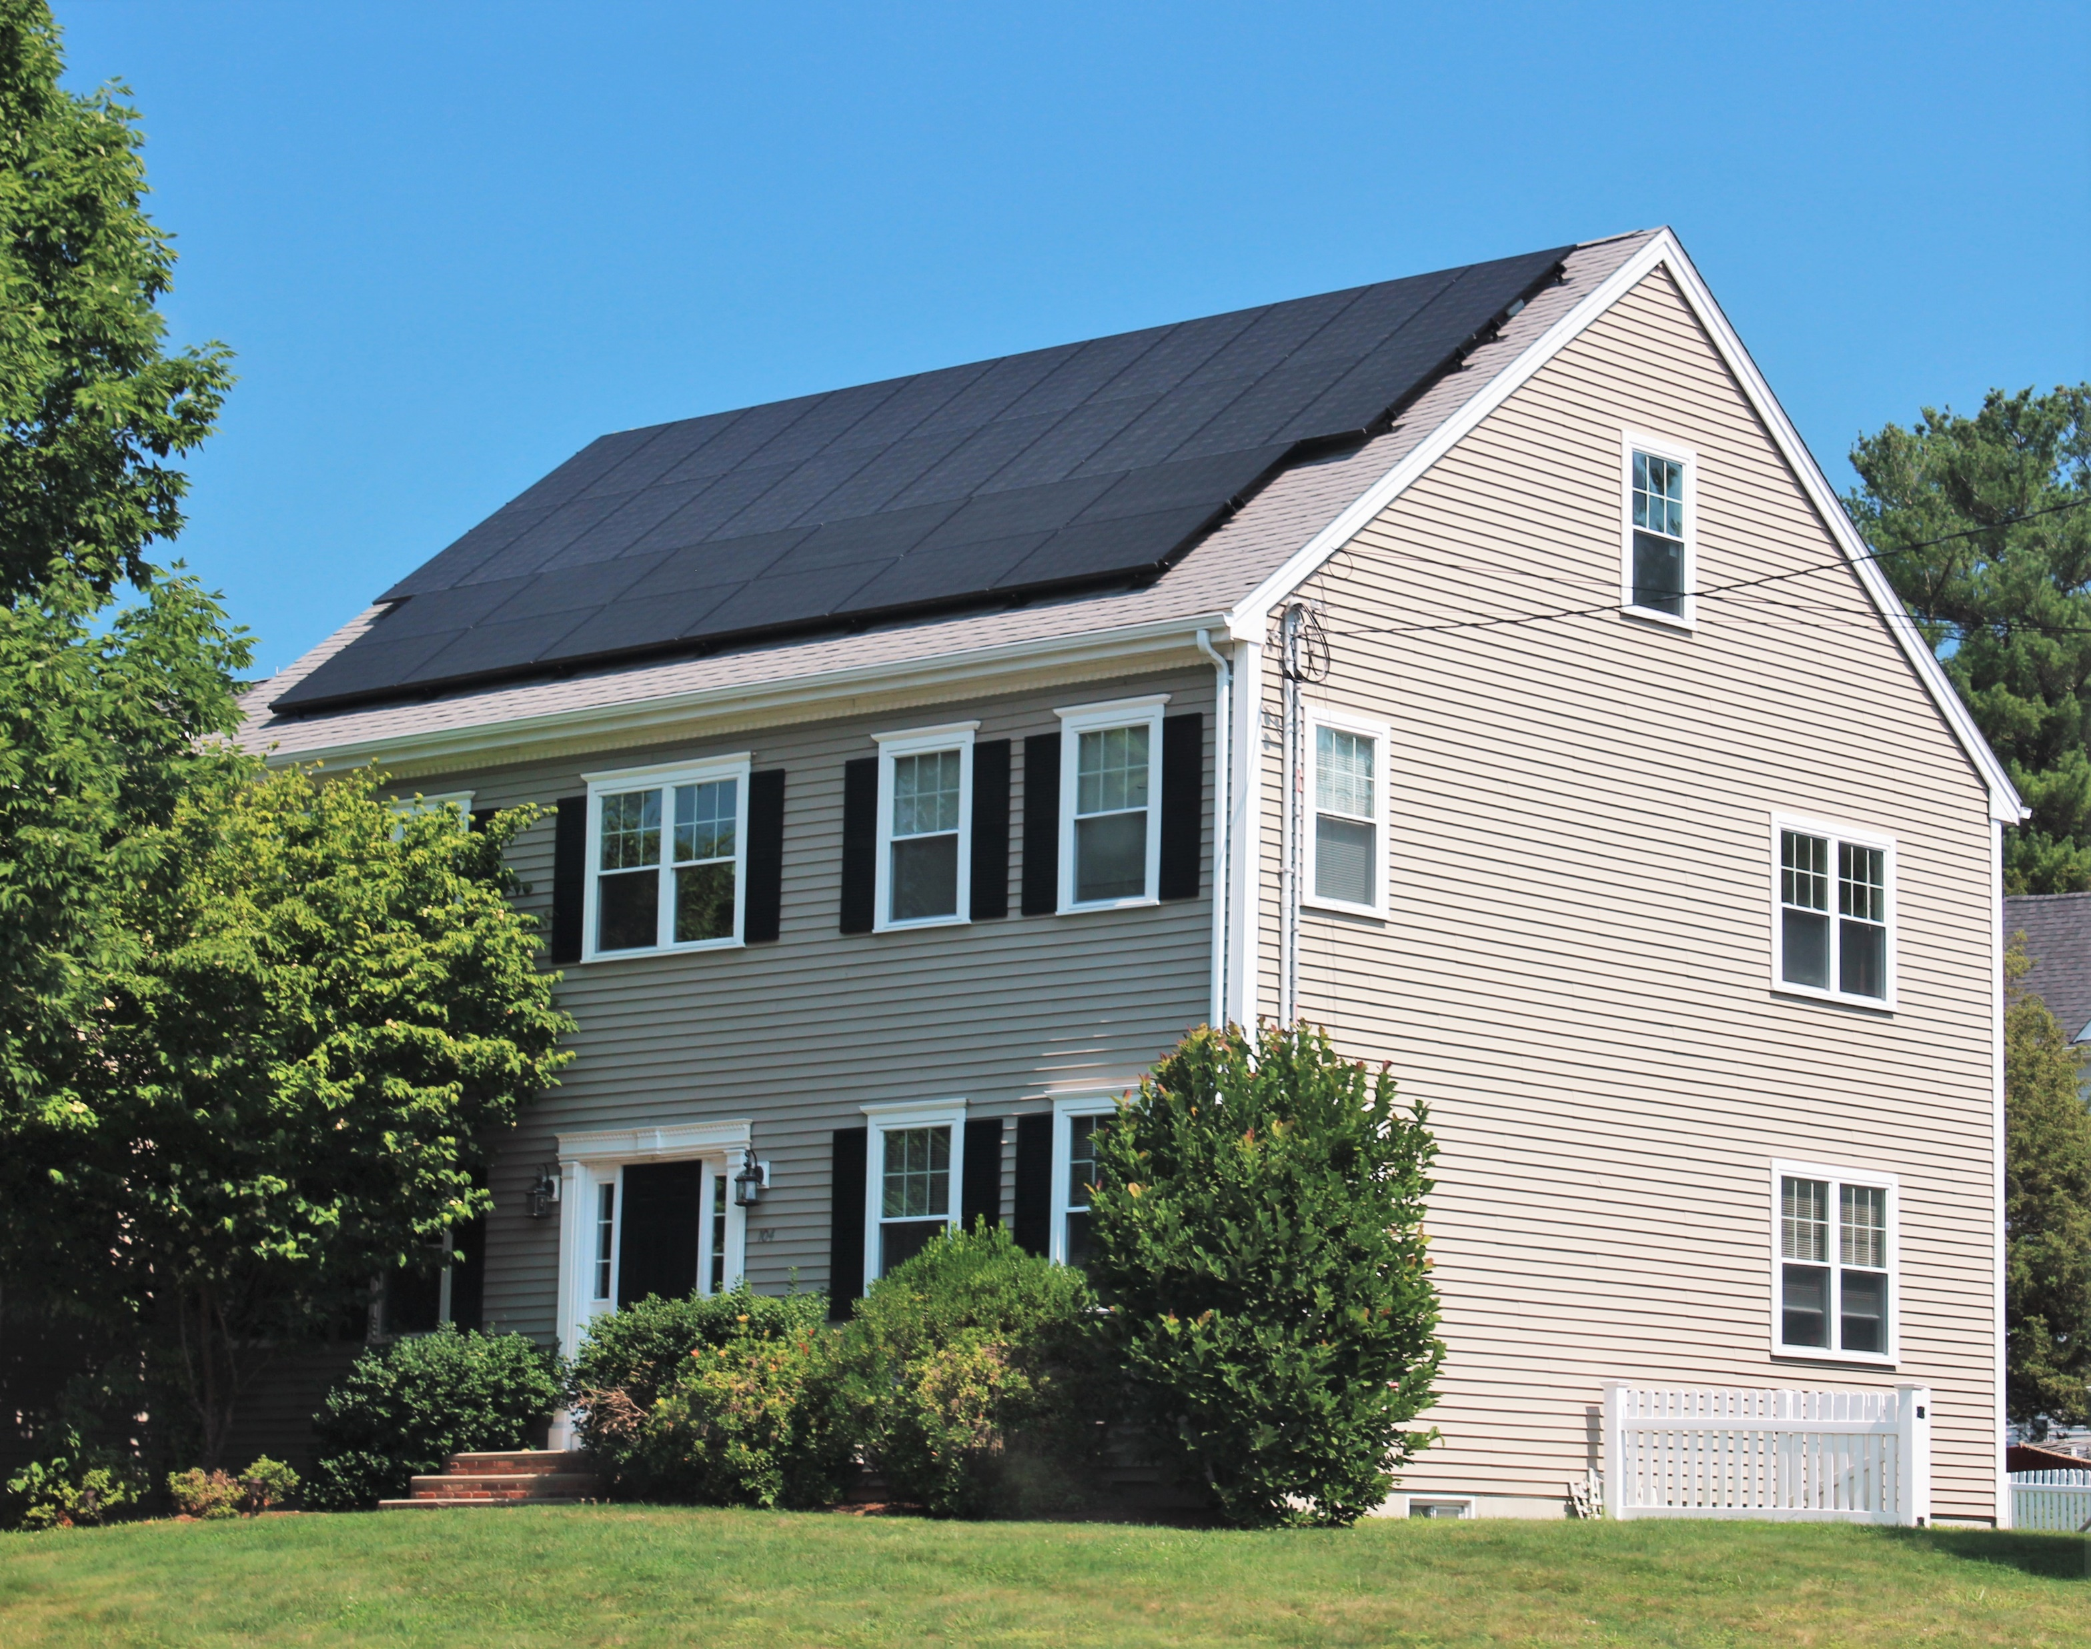

Energy Efficiency Highlights for 2025
Cape and Vineyard Solar Loan: Fully Subscribed
  Loan launched in the fall of 2024. Provides low-interest loans to Cape and Vineyard customers installing new solar PV projects.
  Loans up to $50,000 at 2.75% with a 10-year loan term.
  Phase 2 funding coming December 2025
  Funded through the USDA Rural Energy Services
ENERGY STAR Appliance Rebates
  Room AC - $40
  Electric Clothes Dryer - $50
    Heat Pump Dryer - $200
  Electric Stove (Radiant) - $250
  Electric Stove (Induction) - $500
Refrigerator and Freezer Recycling
  Relaunched program in Q1 2025.
  Customers can recycle and old, working, refrigerator or freezer and receive a $75 rebate
  Customers can schedule a pickup online by visiting the Compact’s website
Notes:
Add to Vineyard version
Oak Bluffs Offer
Turnkey service for moderate-income customers of Oak Bluffs. Covers 100% of the cost of:
Weatherization
Pre-weatherization barriers
Electrification barriers
Whole-home heat pump to replace fossil fuel or electric resistance system - income verification required

Slide 10

Energy Saver Home Loan
The Energy Saver Home Loan Program assist
homeowners to cut their energy use and reduce
or eliminate their reliance on fossil fuels. The Program
will provide financing and technical support to households
for measures not covered by the Cape Light Compact's energy
efficiency program - Mass Save®.
Energy Saver Home Loans will be initiated through Cape Light Compact, and an Energy Service Provider (ESP), Abode Energy Management. The Cape Light Compact will work with participating lenders to assist borrowers through the step-by-step Energy Assessment, Decarbonization Plan, and loan application process.

Slide 11
Energy Saver Home Loan
Eligibility Requirements:
Homeowners must make less than 135% of area median income (AMI)*
  Barnstable County - $167,535
  Dukes County - $206,955
  Nantucket - $220,725
The unit must be a single-family home or one unit in a 2-4 unit multi-family building. The home must be the primary residence.
The proposed work must demonstrate modeled energy savings of at least 20%
*Based on combined income of residents listed on property deed.

Slide 12
Energy Saver Home Loan
Loan Information
Loan amounts range from $10,000 to $100,000
240-month loan term with the following structure
  The first 18 months are interest-only
  Amortized payments for the remaining 222 months
    0.50% interest rates for borrowers below 80% AMI
    2% interest rate for borrowers between 80% and 135% AMI
Rebate are not part of the loan
There are no pre-payment penalties and additional payments can be made as a single payment. Loans can be recast with a minimum principal payment of $2,500 with no fee

Slide 13
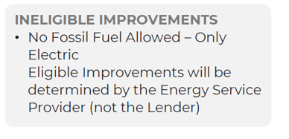
ESHLP Eligible Improvements
Green = major contributors + minor contributors to 20% energy reduction requirement
Black = Add-on measures (once 20% energy reduction is met)
HEALTH AND SAFETY IMPROVEMENTS
Combustion Safety Repair
Mold Remediation
Knob and Tube Wiring Remediation
Asbestos Remediation
Oil Tank Removal
Basement Moisture
Non-structural Leak Repair (cladding, roofing, window, door)
Structural Repair
HVAC
Ventilation
Air Source Heat Pumps
Ground Source Heat Pumps
Thermostats
APPLIANCES, LIGHTING, FIXTURES
Electrical/Induction Cooking (cooktop, range, oven)
Heat Pump Clothes Dryer
Low Flow Faucets and Toilets
LED Lighting
DOMESTIC HOT WATER
Heat Pump Water Heater
Solar Thermal
SITE WORK
Arborist-Approved Shade Trees
Tree Pruning
ENERGY EFFICIENCY/ WEATHERIZATION
Air Sealing and Insulation
Duct Sealing and Insulation
Roofing
Fortified Roofing
White Roofing
Windows
Exterior Doors
ELECTRICAL/CLEAN ENERGY TECHNOLOGIES
Electric Panel Upgrade and Wiring
EV Charging Station
Solar PV
Battery Storage

Slide 14

Small Business Enhancements
Support decarbonization of small businesses by increasing access, improving customer experience, and expanding the workforce
Expand the Customer Directed Option pathway for customers
Expand the renters and landlords enhanced offering
Prioritize support for community-based organizations
  Up to 100% incentives for charitable non-profits
  Main Street events
  Community First Partnership engagement
Joint PA delivery of the Small Business Initiative

Slide 15

Strengthen and Diversify the Workforce
Collaborate with the Massachusetts Clean Energy Center to increase workforce diversity, doubling annual funding from $12 million to $24 million per year. Areas of focus:
  Training for contractors who speak Languages Other Than English (LOTE),
  Business and skill development, barrier removal, and certification support for MWBEs, and
  Comprehensive training and robust wrap around support services to mitigate barriers and increase access and successful outcomes for new entrants.
Continue to hold Supplier Diversity Summits and add a new matchmaking effort to match diverse suppliers with vendors

Slide 16
Compact Enhanced Customer Service
Triage best program
Home Energy and Decarbonization Assessment
Assistance with selected Pathway
CLC Incentives
State Incentives
Federal Incentives
Solar Incentives

Slide 17
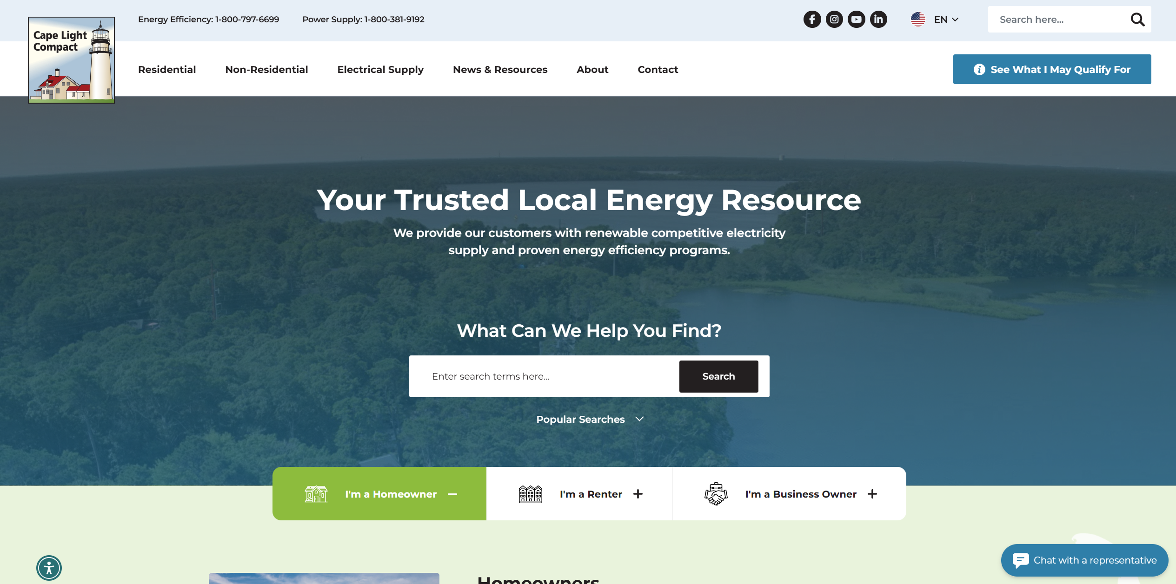
CLC Website Improvements
Over the summer, Cape Light Compact launched a new and enhanced version of their website. The website redesign simplifies the customer journey by improving sitewide navigation, restructuring program pages, and adding new features, including:
Enhanced Menus and Landing Pages
“See What I Qualify for Quiz”
Enhanced Search Functionality
The Compact has also implemented direct chat functionality on the new website. Which allows customers to directly message the Compact’s customer service team and text chat in real time. This gives customers an additional option for contacting the Compact and is especially helpful for customers who may not be able to call or visit the office in person.

Slide 18
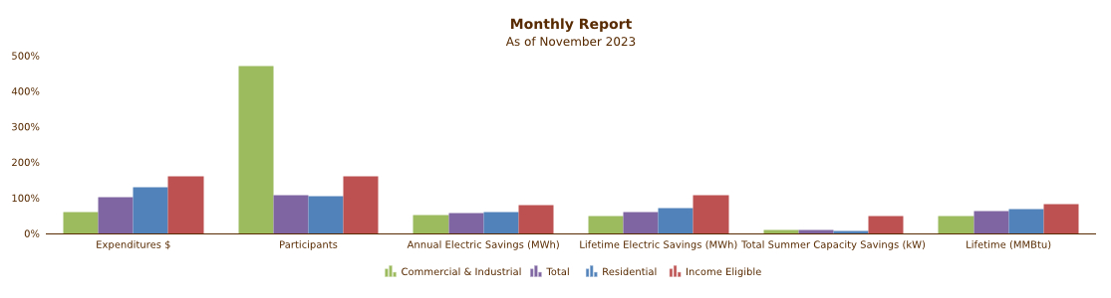
Mass Save Data
Mass Save maintains a website where it publishes all program data.
Masssavedata.com

Slide 19

Energy Efficiency Marketing
Cape Light Compact and Mass Save® do extensive digital and print marketing for our Energy Efficiency Programs including:
  Digital display ads
  Paid google search
  Local and regional newspapers
  Local radio
  Paid social media ads
  And more!
CLC can provide programmatic fliers and marketing material as needed

Slide 20

Community First Partnership
Since 2023, Cape Light Compact has partnered with Vineyard Power to serve residents on the Vineyard.
Boots on the ground support to local residents and small businesses.
Executed 2024 and 2025 tax bill insert campaigns to raise awareness of energy efficiency programming amongst West Tisbury residents.
Over 300 island outreach events between:
  2023 (91)
  2024 (117)
  2025 to date (115)
These events included tabling coordinated by Vineyard Power at local venues across the Island and participation in a wide range of community events. 49 West Tisbury outreach events held at locations such as:
Cronig’s Market
West Tisbury Library
First Congregational Church
Council on Aging
Ag Hall
Notes:
West Tisbury

Slide 21
Power Supply Rates
July ’25 – January ‘26
 | Residential | Commercial | Industrial
 | July ’25 – Jan ’26 cents/kWh | July ’25 – Jan ’26 cents/kWh | Oct ’25 – Jan ‘26 cents/kWh
CLC Standard | 13.219 | 13.253 | 16.172
Local Green 50% | 14.2.19 | 14.253 | 17.172
Local Green 100% | 16.219 | 16.253 | 19.172
Eversource | 14.884 | 15.677 | 18.037

Slide 22
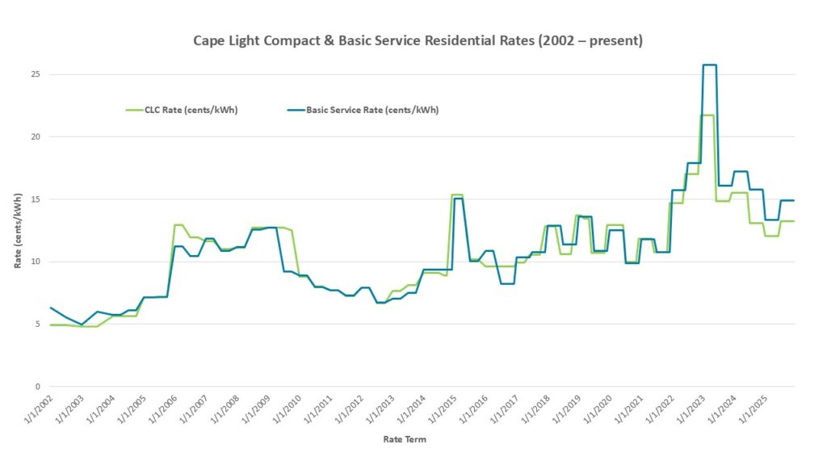
Cape Light Compact & Basic Service Residential Power Supply Rates

Slide 23
What is Driving Higher Prices?
Higher electric prices
Supply
Distribution
Delivery
Transmission
Public policy**
Natural gas prices
Pipeline capacity
Increasing demand
War in Ukraine
Public policy*
*Public policy on the supply side of the bill includes the costs to power suppliers (like CLC, Eversource Basic Service) of purchasing renewable energy certificates to meet state requirements such as the Renewable Portfolio Standard, the Clean Energy Standard, the Clean Peak Standard, and the Alternative Portfolio Standard
**Public policy on the delivery side of the bill includes the energy efficiency programs, solar programs (SMART and net metering), renewable energy, and electric vehicle programs

Slide 24




Stay Up to Date with the CLC
Sign up for our monthly e-newsletter
  https://www.capelightcompact.org/news/newsletter/
Follow the Compact on Social Media:
facebook.com/capelightenergy
@clcenergy
linkedin.com/company/cape-light-compact-jpe/
@capelightcompact2101

Slide 25
Questions?
Energy Efficiency
1-800-797-6699
Power Supply
1-800-381-9192
Visit our Website
www.capelightcompact.org
Your Trusted, Local Energy Resource

